Slide 1
CS 5683: Algorithms & Methods for Big Data Analytics Dimensionality Reduction Basics
Arunkumar Bagavathi
Department of Computer Science
Oklahoma State university

Slide 2
Course Topics Until Now
Frameworks
High. Dim. Data
Applications
Map Reduce
Dimensionality Reduction
Association Rules
Spark
Locality Sensitive Hashing

Slide 3
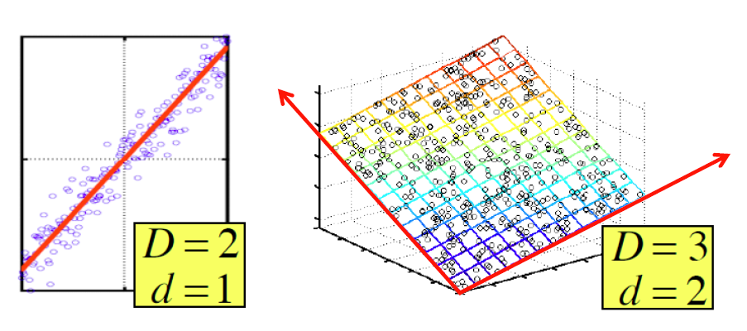
Dimensionality Reduction
Assumption: Data lies on or near a low d-dimensional subspace
Axes of this subspace are effective representation of the data

Slide 4
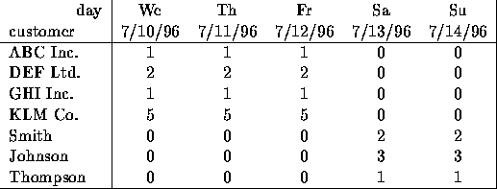
Dimensionality Reduction
Compress / reduce dimensionality:
10⁶ rows; 10³ columns; no updates
Random access to any cell(s); small error: OK
The above matrix is really “2-dimensional.” All rows can be reconstructed by scaling [1 1 1 0 0] or [0 0 0 1 1]

Slide 5
Dimensionality Reduction
Goal of dimensionality reduction: to discover the axis of data!
Rather than representing every point with 2 coordinates we represent each point with
1 coordinate (corresponding to the position of the point on the red line).
By doing this we incur a bit of error as the points do not exactly lie on the line

Slide 6
Why Reduce Dimensions
Why reduce dimensions?
Discover hidden correlations/topics
Words that occur commonly together
Remove redundant and noisy features
Not all words are useful
Interpretation and visualization
Easier storage and processing of the data

Slide 7
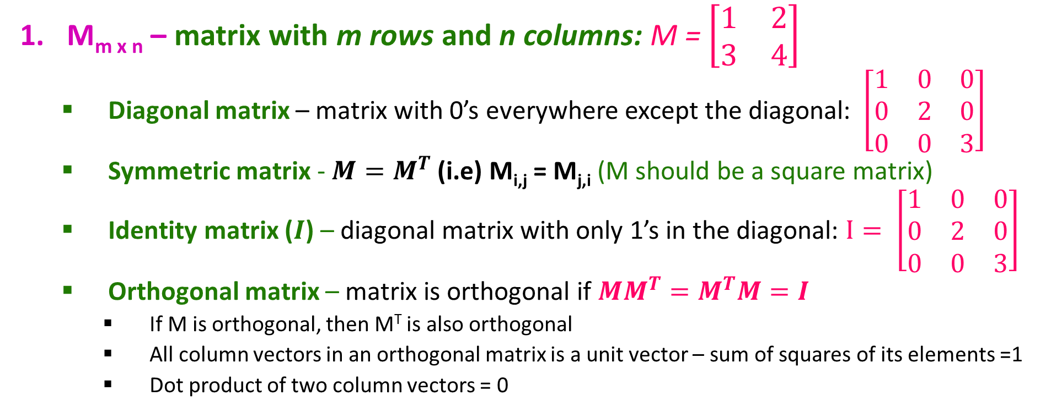
Linear Algebra Throwback
M_{m x n} – matrix with m rows and n columns: M = $\left[\begin{matrix}1 & 2 \\ 3 & 4\end{matrix}\right]$
Diagonal matrix – matrix with 0’s everywhere except the diagonal: $\left[\begin{matrix}1 & 0 & 0 \\ 0 & 2 & 0 \\ 0 & 0 & 3\end{matrix}\right]$
Symmetric matrix - $M=M^{T}$ (i.e) M_{i,j} = M_{j,i} (M should be a square matrix)
Identity matrix ($I$) – diagonal matrix with only 1’s in the diagonal: $I= \left[\begin{matrix}1 & 0 & 0 \\ 0 & 2 & 0 \\ 0 & 0 & 3\end{matrix}\right]$
Orthogonal matrix – matrix is orthogonal if $MM^{T}=M^{T}M=I$
If M is orthogonal, then M^{T} is also orthogonal
All column vectors in an orthogonal matrix is a unit vector – sum of squares of its elements =1
Dot product of two column vectors = 0

Slide 8
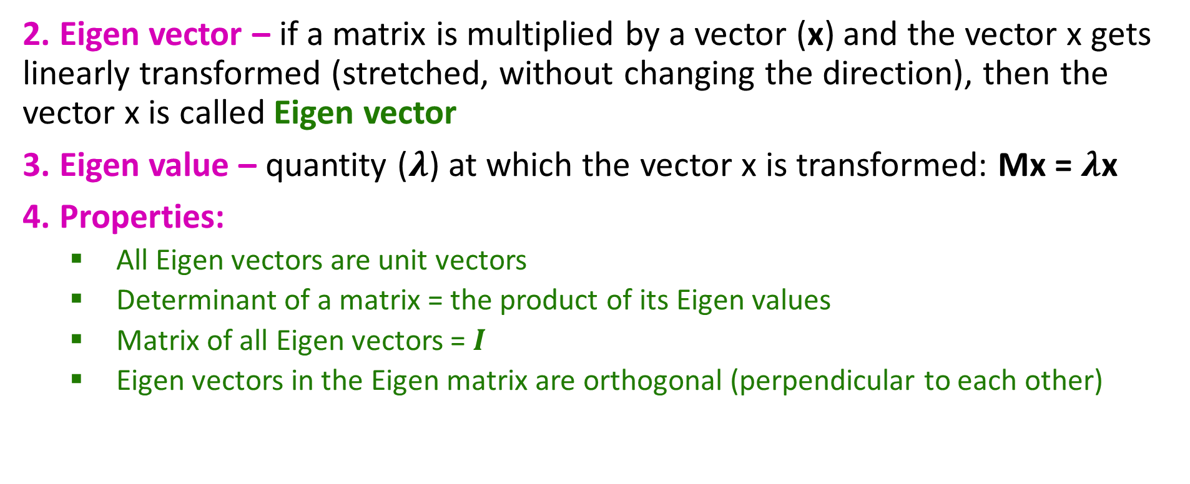
Linear Algebra Throwback
2. Eigen vector – if a matrix is multiplied by a vector (x) and the vector x gets linearly transformed (stretched, without changing the direction), then the vector x is called Eigen vector
3. Eigen value – quantity ($λ$) at which the vector x is transformed: Mx = $λ$x
4. Properties:
All Eigen vectors are unit vectors
Determinant of a matrix = the product of its Eigen values
Matrix of all Eigen vectors = $I$
Eigen vectors in the Eigen matrix are orthogonal (perpendicular to each other)

Slide 9
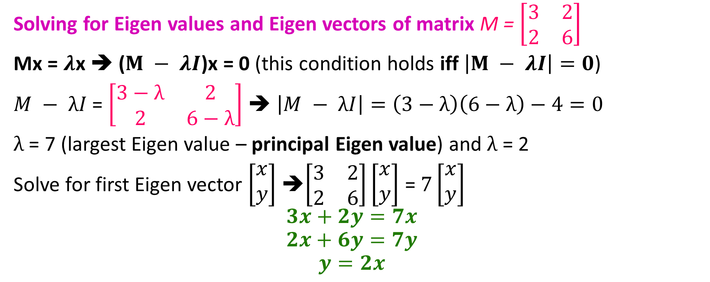
Linear Algebra Throwback
Solving for Eigen values and Eigen vectors of matrix M = $\left[\begin{matrix}3 & 2 \\ 2 & 6\end{matrix}\right]$
Mx = $λ$x ➔ ($M − λI$)x = 0 (this condition holds iff $\left|M − λI\right|=0$)
$M − λI$ = $\left[\begin{matrix}3−λ & 2 \\ 2 & 6−λ\end{matrix}\right]$ ➔ $\left|M − λI\right|=\left(3−λ\right)\left(6−λ\right)−4=0$
$λ$ = 7 (largest Eigen value – principal Eigen value) and $λ$ = 2
Solve for first Eigen vector $\left[\begin{matrix}x \\ y\end{matrix}\right]$ ➔$\left[\begin{matrix}3 & 2 \\ 2 & 6\end{matrix}\right]\left[\begin{matrix}x \\ y\end{matrix}\right]$ = $7\left[\begin{matrix}x \\ y\end{matrix}\right]$
$$3x+2y=7x$$
$$2x+6y=7y$$
$$y=2x$$

Slide 10
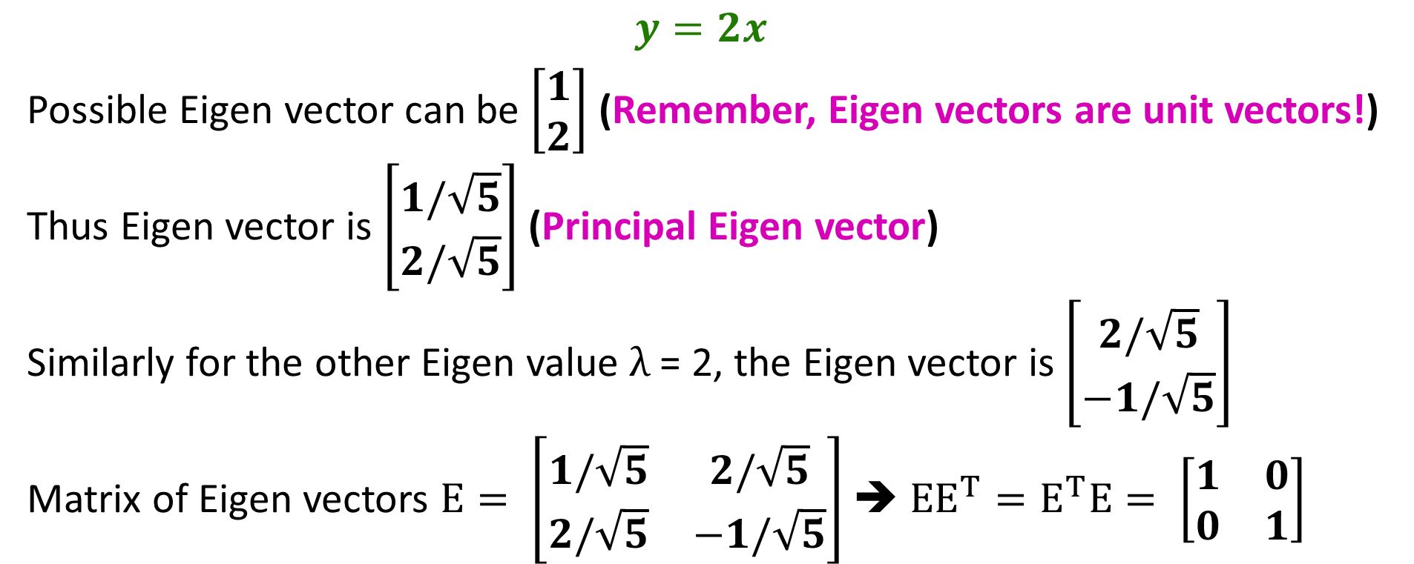
Linear Algebra Throwback
$$y=2x$$
Possible Eigen vector can be $\left[\begin{matrix}1 \\ 2\end{matrix}\right]$ (Remember, Eigen vectors are unit vectors!)
Thus Eigen vector is $\left[\begin{matrix}1/\sqrt{5} \\ 2/\sqrt{5}\end{matrix}\right]$ (Principal Eigen vector)
Similarly for the other Eigen value $λ$ = 2, the Eigen vector is $\left[\begin{matrix}2/\sqrt{5} \\ −1/\sqrt{5}\end{matrix}\right]$
Matrix of Eigen vectors $E= \left[\begin{matrix}1/\sqrt{5} & 2/\sqrt{5} \\ 2/\sqrt{5} & −1/\sqrt{5}\end{matrix}\right]$ ➔ ${EE}^{T}=E^{T}E= \left[\begin{matrix}1 & 0 \\ 0 & 1\end{matrix}\right]$

Slide 11
Principal Component Analysis
A data mining technique that identifies the projection of the high-dimensional data onto which the data tuples align the best
In other words: Find Eigen vectors of the original data – the Principal Eigen vector represents an axis in which most data points reside

Slide 12
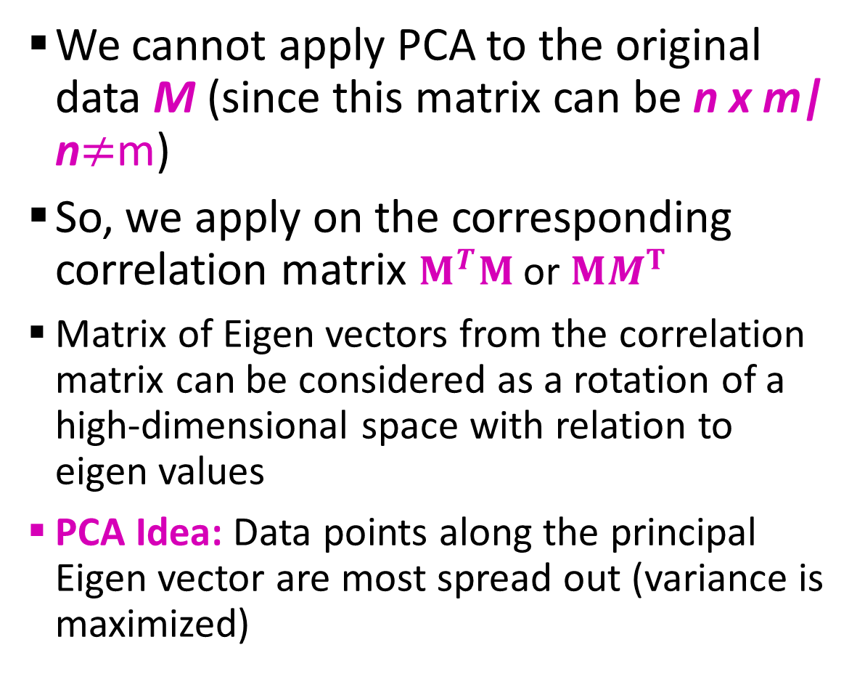
Principal Component Analysis
We cannot apply PCA to the original data M (since this matrix can be n x m| n$≠$m)
So, we apply on the corresponding correlation matrix $M^{T}M$ or $MM^{T}$
Matrix of Eigen vectors from the correlation matrix can be considered as a rotation of a high-dimensional space with relation to eigen values
PCA Idea: Data points along the principal Eigen vector are most spread out (variance is maximized)
Notes:
Correlation matrix entries – inter-product of columns
High – two solumns are similar
Low – two columns are dissimilar

Slide 13
PCA – Dimensionality Reduction
The original high-dimensional space is mapped to a coordinate space by multiplying the original data M and Eigen matrix E ➔ ME = M’
M’ → the first axis corresponds to the largest eigen value, the second axis corresponds to the seconds largest eigen values, and so on
To reduce the data dimension, we only consider eigen vectors that corresponds to largest eigen values

Slide 14

Rank of a Matrix
Q: What is rank of a matrix A?
A: Number of linearly independent rows of A
For example:
Matrix A = has rank r=2
Why? The first two rows are linearly independent, so the rank is at least 2, but all three rows are linearly dependent (the first is equal to the sum of the second and third) so the rank must be less than 3.
Why do we care about low rank?
We can write A as two “basis” vectors: [1 2 1] [-2 -3 1]
And new coordinates of : [1 0] [0 1] [1 1]

Slide 15
Rank is Dimensionality
Cloud of points 3D space:
Think of point positions as a matrix:
We can rewrite coordinates more efficiently!
Old basis vectors: [1 0 0] [0 1 0] [0 0 1]
New basis vectors: [1 2 1] [-2 -3 1]
Then A has new coordinates: [1 0]. B: [0 1], C: [1 1]
Notice: We reduced the number of coordinates!
A
B
C
1 row per point:

Slide 16
Singular Value Decomposition
A_{[m x n]} = U_{[m x r]} Σ _{[ r x r]} (V_{[n x r]})^{T}
A: Input data matrix
m x n matrix (e.g., m documents, n terms)
U: Left singular vectors
m x r matrix (m documents, r concepts)
Σ: Singular values
r x r diagonal matrix (strength of each ‘concept’) (r : rank of the matrix A)
V: Right singular vectors
n x r matrix (n terms, r concepts)

Slide 17
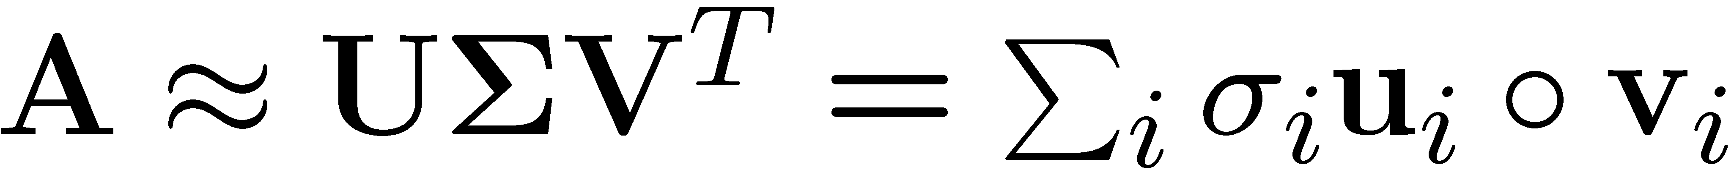
SVD
n
n
A
≈
Σ
V^{T}
m
m

Slide 18
SVD
σ₁u₁v₁
σ₂u₂v₂
A
≈
+
σ_{i} … scalar
u_{i} … vector
v_{i} … vector

Slide 19
SVD - Properties
It is always possible to decompose a real matrix A into A = U Σ V^{T} , where
U, Σ, V: unique
U, V: column orthonormal
U^{T} U = I; V^{T} V = I (I: identity matrix)
(Columns are orthogonal unit vectors)
Σ: diagonal
Entries (singular values) are positive, and sorted in decreasing order (σ₁ ≥ σ₂ ≥ ... ≥ 0)

Slide 20
SVD – Example: Users-to-Movies
Matrix
Alien
Serenity
Casablanca
Amelie
A = U Σ V^{T} - example: Users to Movies
n
1 1 1 0 0
3 3 3 0 0
4 4 4 0 0
5 5 5 0 0
0 2 0 4 4
0 0 0 5 5
0 1 0 2 2
SciFi
Σ
V^{T}
=
m
Romance
U
“Concepts” AKA Latent dimensions AKA Latent factors

Slide 21
SVD – Example: Users-to-Movies
Matrix
Alien
Serenity
Casablanca
Amelie
A = U Σ V^{T} - example: Users to Movies
1 1 1 0 0
3 3 3 0 0
4 4 4 0 0
5 5 5 0 0
0 2 0 4 4
0 0 0 5 5
0 1 0 2 2
0.13 0.02 -0.01
0.41 0.07 -0.03
0.55 0.09 -0.04
0.68 0.11 -0.05
0.15 -0.59 0.65
0.07 -0.73 -0.67
0.07 -0.29 0.32
SciFi
12.4 0 0
0 9.5 0
0 0 1.3
=
x
x
Romnce
0.56 0.59 0.56 0.09 0.09
0.12 -0.02 0.12 -0.69 -0.69
0.40 -0.80 0.40 0.09 0.09

Slide 22
SVD – Example: Users-to-Movies
Matrix
Alien
Serenity
Casablanca
Amelie
A = U Σ V^{T} - example: Users to Movies
U is “user-to-concept” matrix
SciFi-concept
Romance-concept
1 1 1 0 0
3 3 3 0 0
4 4 4 0 0
5 5 5 0 0
0 2 0 4 4
0 0 0 5 5
0 1 0 2 2
0.13 0.02 -0.01
0.41 0.07 -0.03
0.55 0.09 -0.04
0.68 0.11 -0.05
0.15 -0.59 0.65
0.07 -0.73 -0.67
0.07 -0.29 0.32
SciFi
12.4 0 0
0 9.5 0
0 0 1.3
=
x
x
Romnce
0.56 0.59 0.56 0.09 0.09
0.12 -0.02 0.12 -0.69 -0.69
0.40 -0.80 0.40 0.09 0.09

Slide 23
SVD – Example: Users-to-Movies
Matrix
Alien
Serenity
Casablanca
Amelie
A = U Σ V^{T} - example: Users to Movies
SciFi-concept
“strength” of the SciFi-concept
1 1 1 0 0
3 3 3 0 0
4 4 4 0 0
5 5 5 0 0
0 2 0 4 4
0 0 0 5 5
0 1 0 2 2
0.13 0.02 -0.01
0.41 0.07 -0.03
0.55 0.09 -0.04
0.68 0.11 -0.05
0.15 -0.59 0.65
0.07 -0.73 -0.67
0.07 -0.29 0.32
SciFi
12.4 0 0
0 9.5 0
0 0 1.3
=
x
x
Romnce
0.56 0.59 0.56 0.09 0.09
0.12 -0.02 0.12 -0.69 -0.69
0.40 -0.80 0.40 0.09 0.09

Slide 24
SVD – Example: Users-to-Movies
Matrix
Alien
Serenity
Casablanca
Amelie
A = U Σ V^{T} - example: Users to Movies
V is “movie-to-concept”
similarity matrix
SciFi-concept
1 1 1 0 0
3 3 3 0 0
4 4 4 0 0
5 5 5 0 0
0 2 0 4 4
0 0 0 5 5
0 1 0 2 2
0.13 0.02 -0.01
0.41 0.07 -0.03
0.55 0.09 -0.04
0.68 0.11 -0.05
0.15 -0.59 0.65
0.07 -0.73 -0.67
0.07 -0.29 0.32
SciFi
12.4 0 0
0 9.5 0
0 0 1.3
=
x
x
Romnce
0.56 0.59 0.56 0.09 0.09
0.12 -0.02 0.12 -0.69 -0.69
0.40 -0.80 0.40 0.09 0.09
SciFi-concept

Slide 25
SVD – Interpretation #1
‘movies’, ‘users’ and ‘concepts’:
U: user-to-concept similarity matrix
V: movie-to-concept similarity matrix
Σ: its diagonal elements: ‘strength’ of each concept

Slide 26
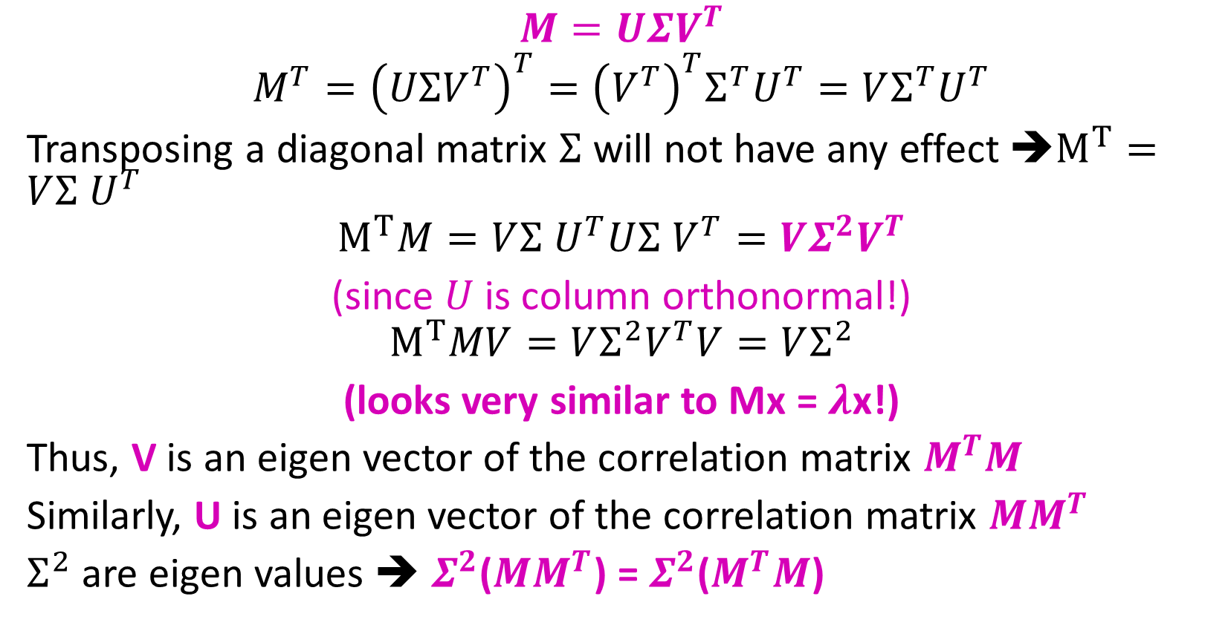
Solving SVD
$$M=UΣV^{T}$$
$$M^{T}={\left(UΣV^{T}\right)}^{T}={\left(V^{T}\right)}^{T}Σ^{T}U^{T}=VΣ^{T}U^{T}$$
Transposing a diagonal matrix $Σ^{ }$will not have any effect ➔$M^{T}=VΣ^{ }U^{T}$
$$M^{T}M=VΣ^{ }U^{T}UΣ^{ }V^{T}=VΣ^{2}V^{T}$$
(since $U$ is column orthonormal!)
$$M^{T}MV=VΣ^{2}V^{T}V=VΣ^{2}$$
(looks very similar to Mx = $λ$x!)
Thus, V is an eigen vector of the correlation matrix $M^{T}M$
Similarly, U is an eigen vector of the correlation matrix ${MM}^{T}$
$Σ^{2}$ are eigen values ➔ $Σ^{2}$(${MM}^{T}$) = $Σ^{2}$($M^{T}M$)

Slide 27

Questions???

Slide 28
Acknowledgements
Most of this lecture slides are obtained from the Mining Massive Datasets course: http://www.mmds.org/

